Slide 1


Target Marketing for Canadian Bank
In-Class Kaggle Competition
Introduction to Artificial Intelligence
2023F AML 1413 1
GAMMA_A

Slide 2







MODELS
PROCESSING
FINDINGS
BASE MODEL
DATASET

Slide 3
Data
UNDERSTANDINGS
DATASET
PROPERTIES
FEATURES

Slide 4
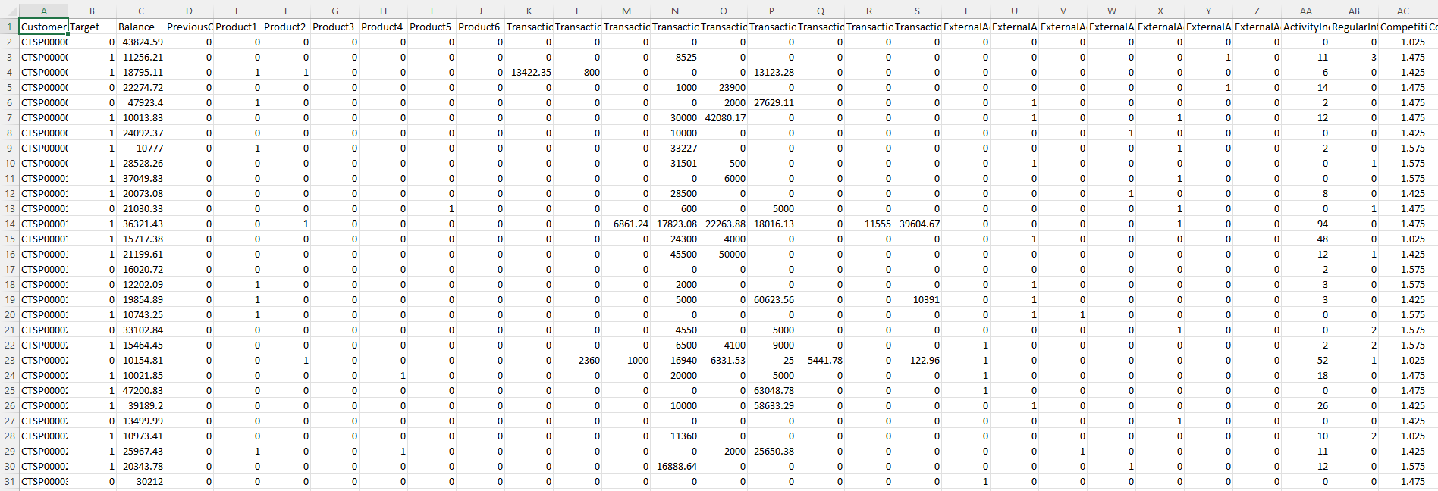
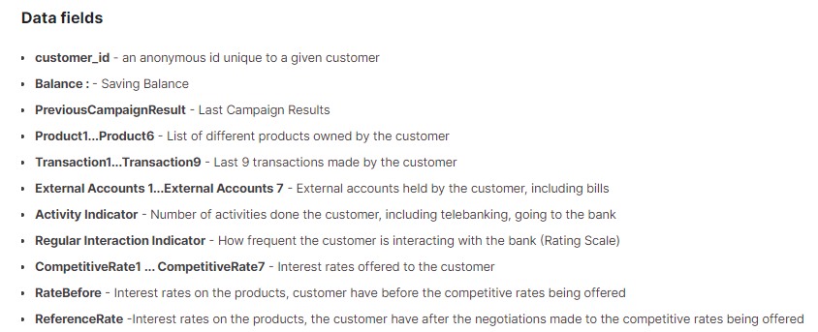
VIEW_IN_EXCEL
DOMAIN_UNDERSTANDING

Slide 5
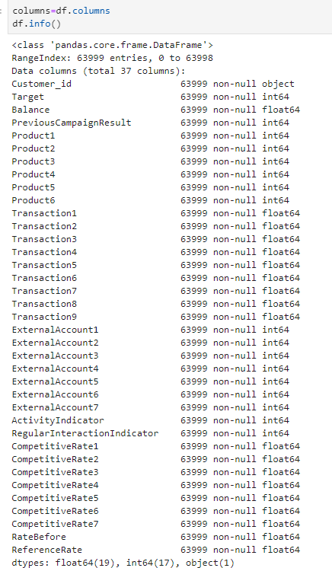
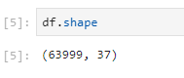
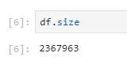
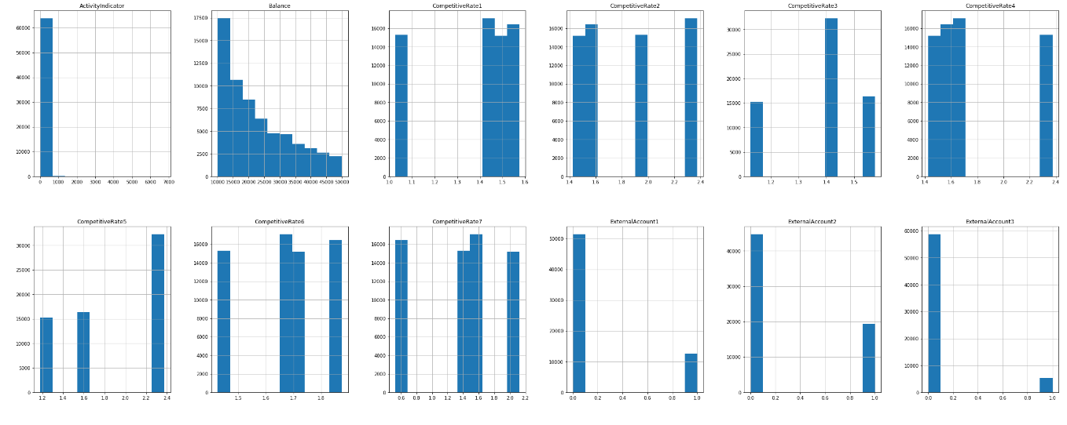
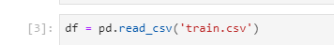
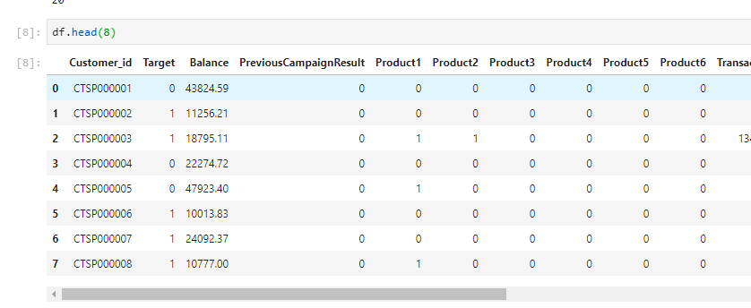
SHAPE & SIZE
HISTOGRAM
LOADING_DATA
NON_NULL | DATA TYPE

Slide 6
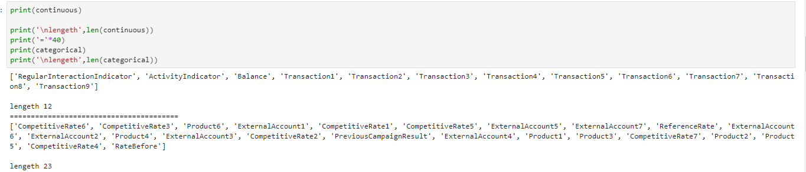


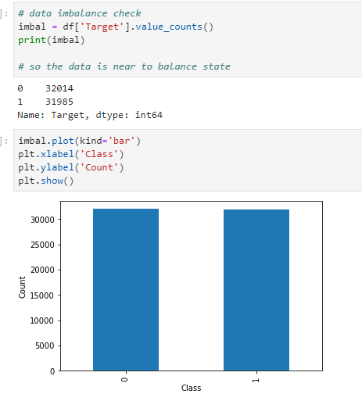
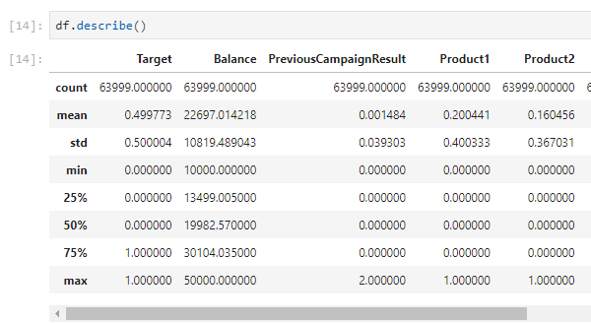

NUMERICAL_COLUMNS
CATEGORICAL_COLUMNS
TARGET
STATISTICAL ANALYSIS
LABEL_BALANCE

Slide 7
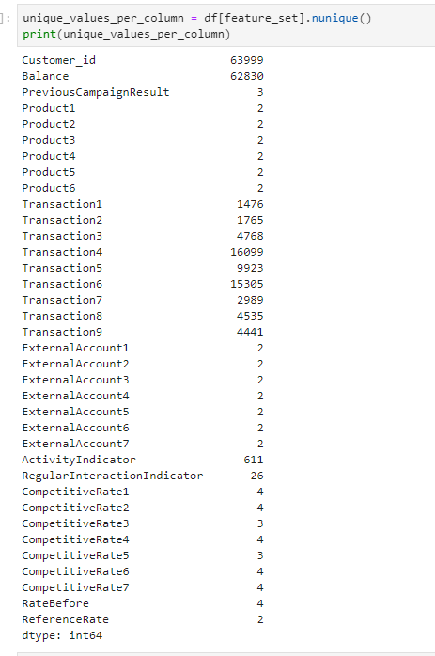
PROCESSING
MISSING VALUES - NULL
PRE-PROCESSING
SPECIAL CHARACTERS
REMOVING UNWANTED COLUMNS
SUMMING UP
STANDARDIZATION
NORMALIZATION
ALREADY LABEL ENCODED

Slide 8
BASE MODEL
MODEL
PIPELINE
RESULTS
TUNING

Slide 9
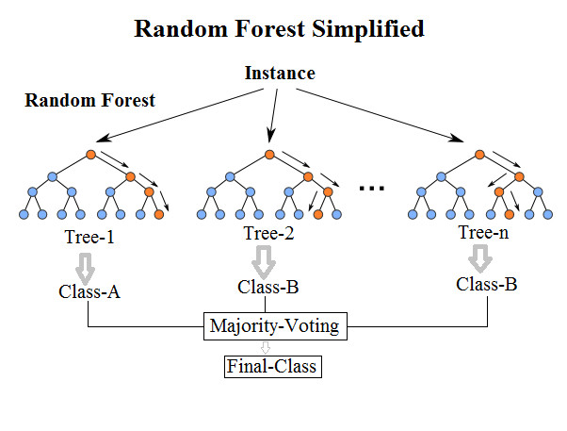
RANDOM FOREST
many individual trees.
Each tree will give ‘class prediction’ as output.
The class that has more votes is the final prediction of the model.

Slide 10
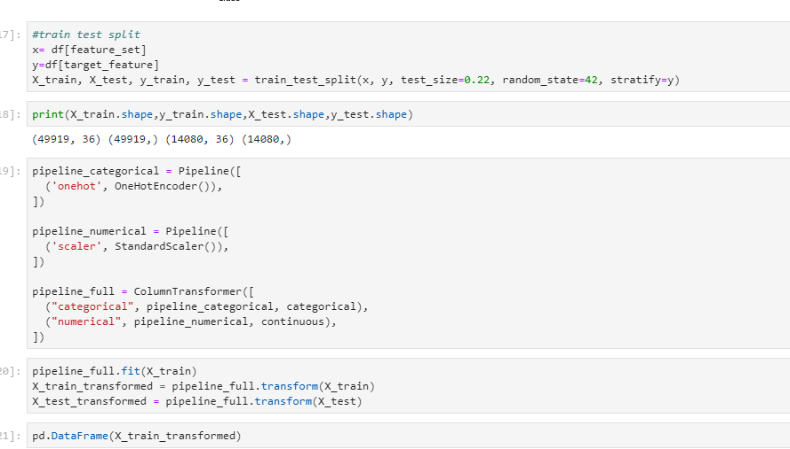
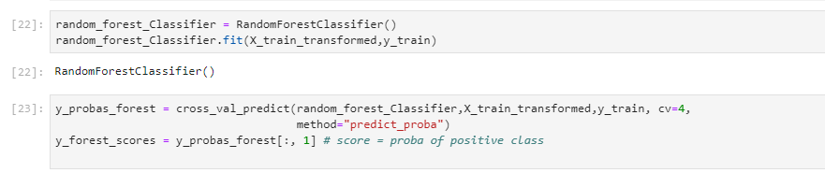
SPLITTING - STRATIFIED
SHAPE OF TEST | TRAIN
CATEGORICAL
NUMERICAL
CREATING PIPELINE
FITTING 🡺 LEARNING
TRANSFORM 🡪 APPLYING THE LEARNING

Slide 11
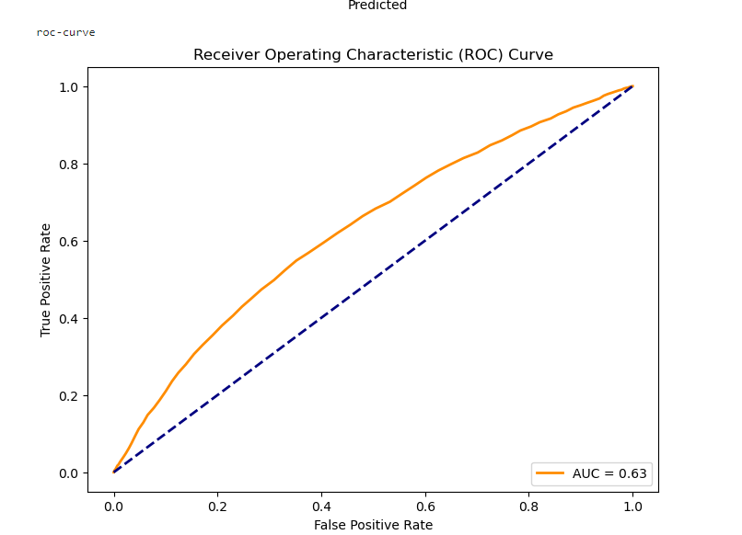
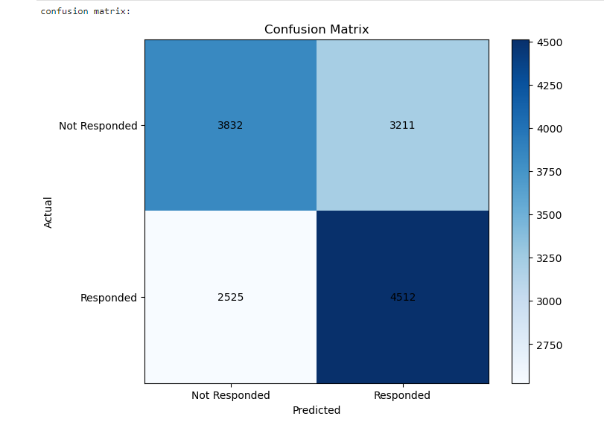
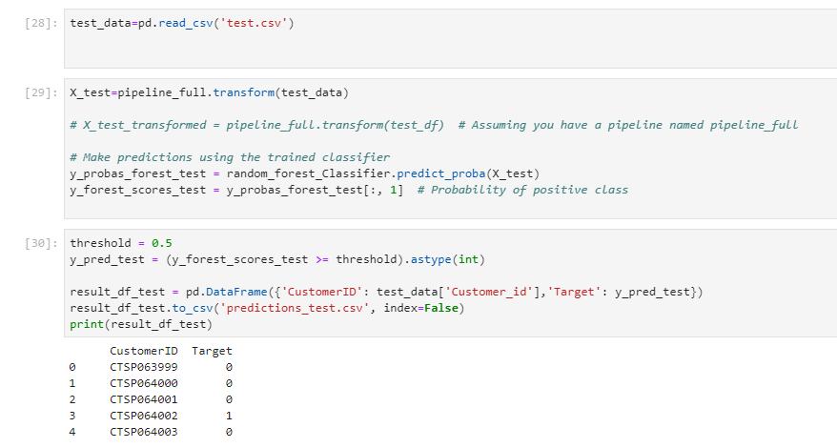
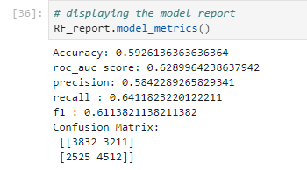

Slide 12
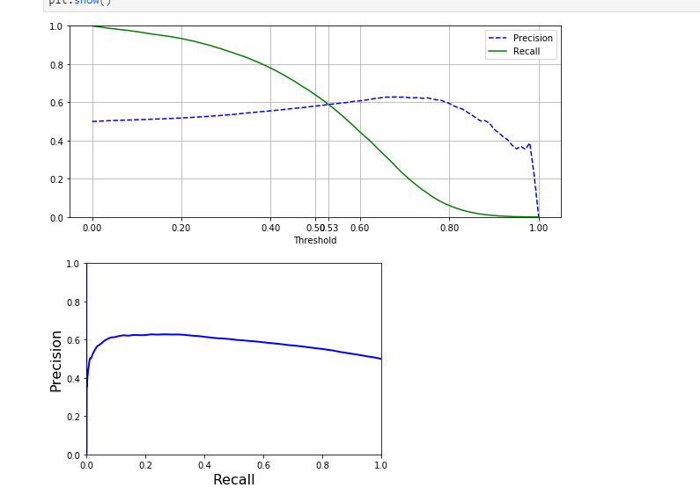
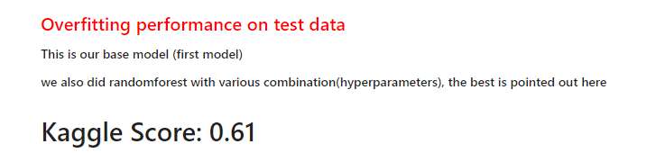
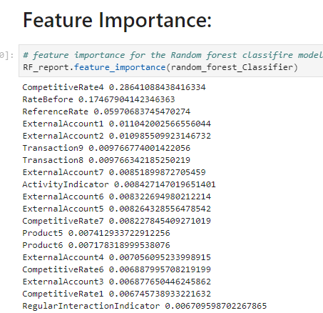
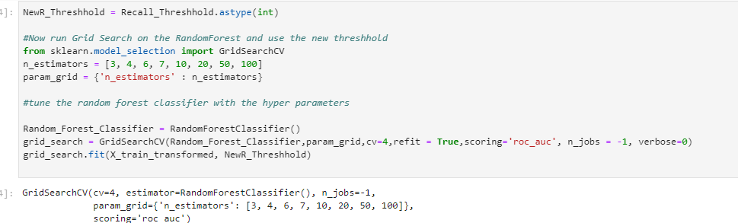
TRAINING DATA: 0.65

Slide 13
MODELS
MODEL_2
MODEL_3
MODEL_4
MODEL_5
MODEL_6
MODEL_7

Slide 14
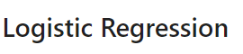
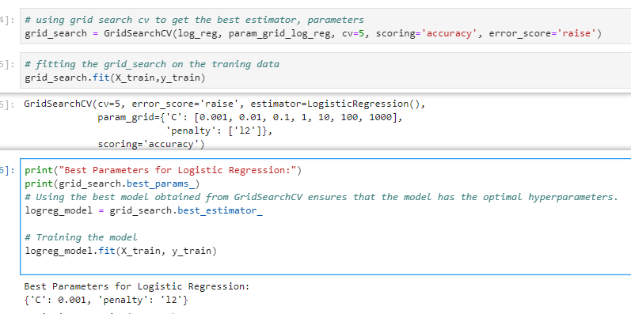
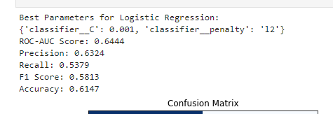
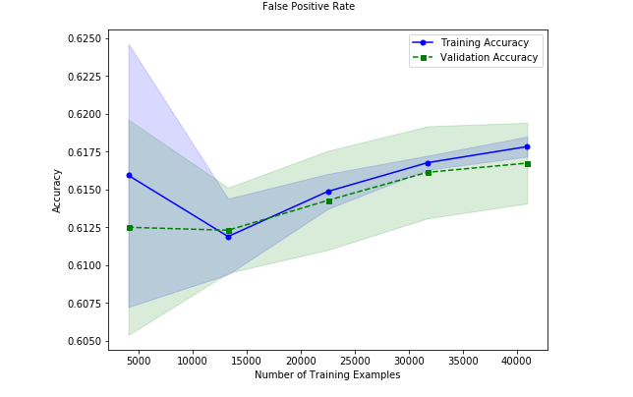
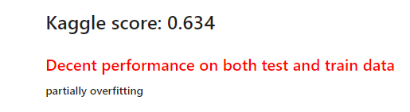
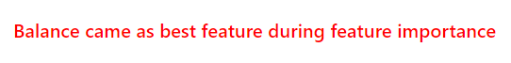

Slide 15
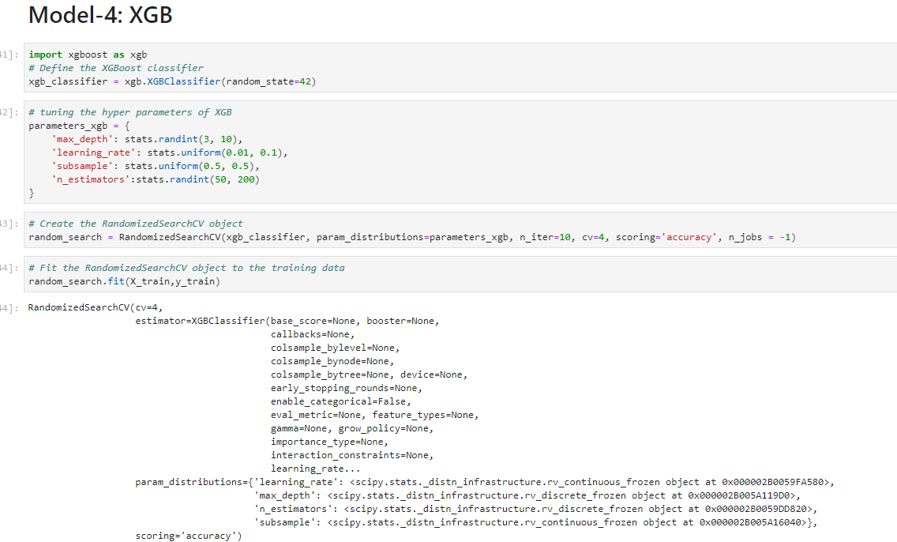
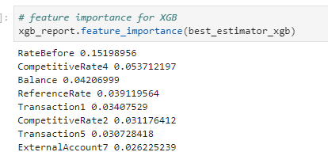
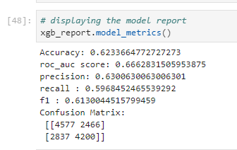
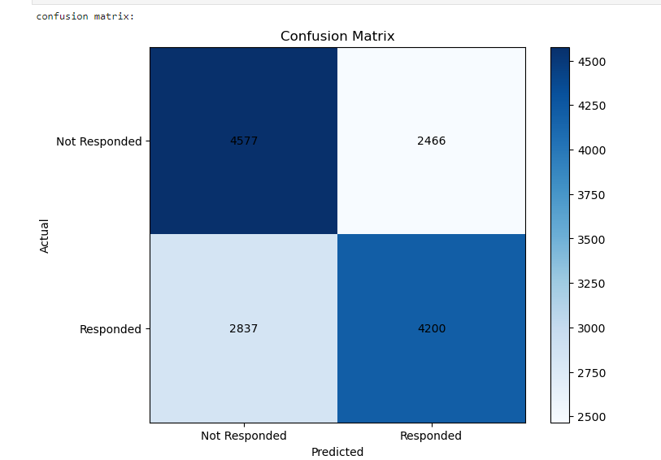
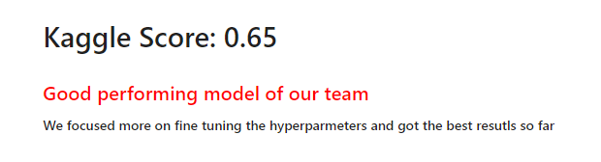

Slide 16
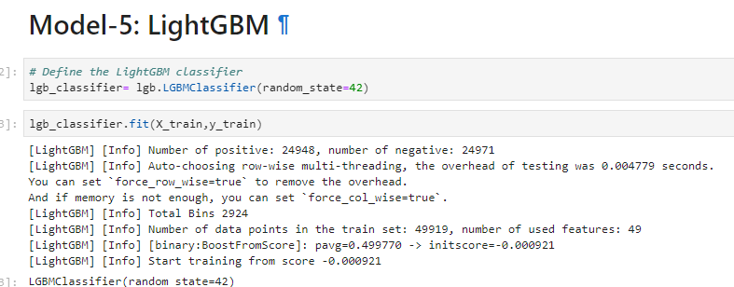
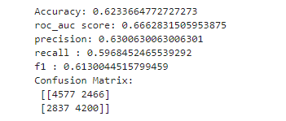

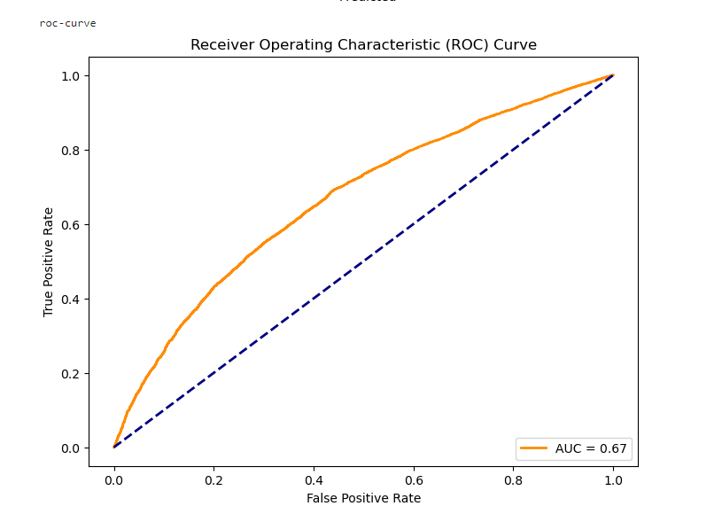
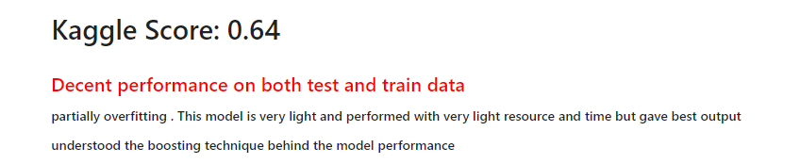
FAST
LIGHT_WEIGHT GOOD_PERFORMANCE

Slide 17
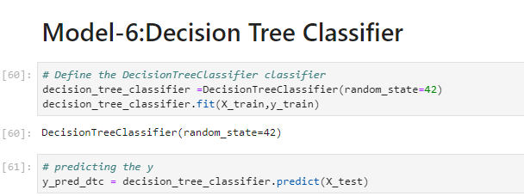
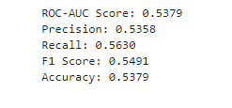
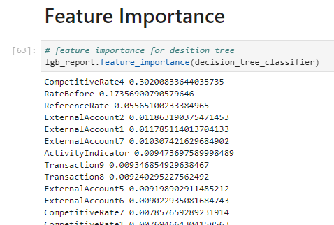
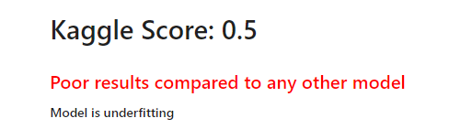

Slide 18
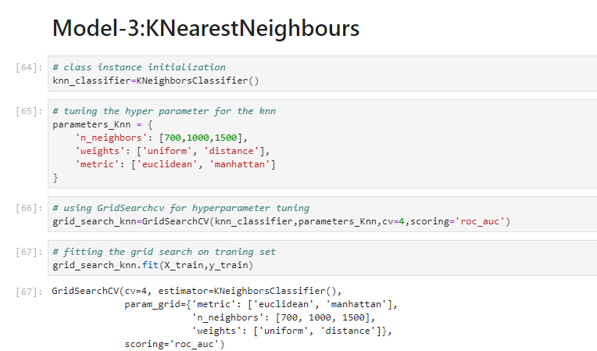
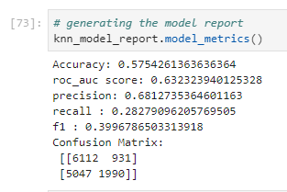
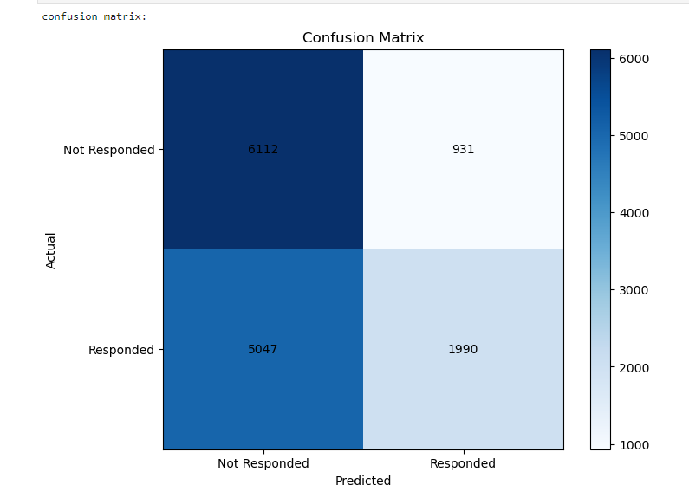
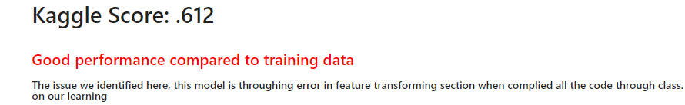

Slide 19
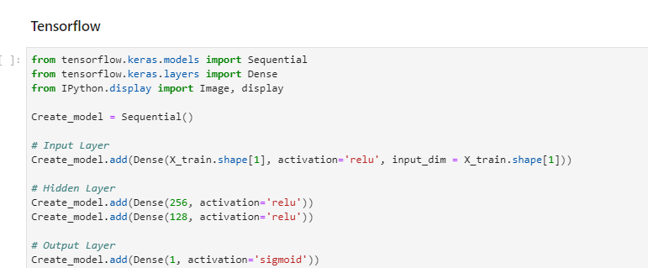
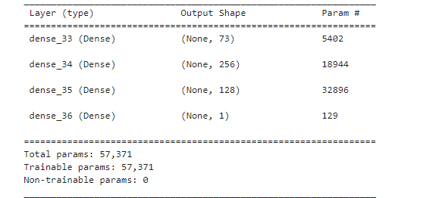
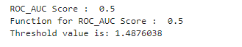
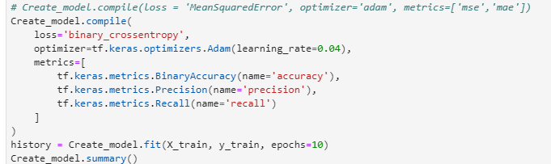
KAGGLE SCORE: .57

Slide 20
FINDINGS
AREA OF IMPROVEMENT
OUR ANALYSIS

Slide 21




Slide 22






Using a data frame selector before one-hot encoding gave us 73 features, showing how encoding expanded our data's dimensions

Slide 23








Aanal Kamleshkumar Patel
C0910376
Anoohya Ch
C912903
Ganapathy Subramaniam Sundar
C0908063
Jayachandhran Saravanan
C0910392
Rohan Aryan
C0912902
Ritish Madaan
C0908005
Sarfaraz Ali Khan
C0912921

Slide 24
Reference:
Tensor: https://www.tensorflow.org/guide/tensor
Sklearn_documentation: https://scikit-learn.org/0.21/documentation.html
Matplotlib — Visualization with Python. (n.d.). https://matplotlib.org/
seaborn: statistical data visualization — seaborn 0.13.0 documentation. (n.d.). https://seaborn.pydata.org/
NumPy. (n.d.). https://numpy.org/
pandas - Python Data Analysis Library. (n.d.). https://pandas.pydata.org/

Slide 25
sklearn.preprocessing.LabelEncoder. (n.d.). Scikit-learn. https://scikit-learn.org/stable/modules/generated/sklearn.preprocessing.LabelEncoder.html
warnings — Warning control. (n.d.). Python Documentation. https://docs.python.org/3/library/warnings.html
Ahsan, N. (2023, March 25). How I setup my Windows Machine for Deep Learning - Analytics Vidhya - medium. Medium. https://medium.com/analytics-vidhya/how-i-setup-my-windows-machine-for-deep-learning-82358a939c74
Kumar, N., PhD. (2021, April 26). Random Forest Algorithm, an interactive discussion. https://www.linkedin.com/pulse/random-forest-algorithm-interactive-discussion-niraj-kumar/

Slide 26
QUESTIONS
THANK YOU!

